Slide 1
Celestial Bodies Wiki
By Kaloyan Dimitrov

Slide 2
Introduction
Celestial Bodies Wiki is your guide to exploring stars, planets, and satellites. This platform helps you search, sort, and add celestial bodies easily. Join us as we uncover information about these cosmic entities and navigate the universe together!

Slide 3
Key Features
Search Function
Display Options: Alphabetical & by mass
Add New Entries: Stars, Planets, Satellites

Slide 4
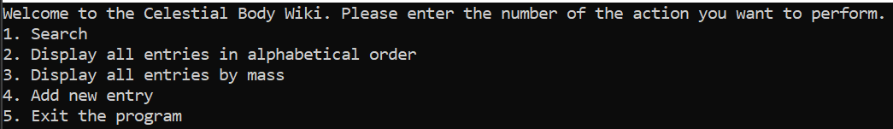
Navigation Overview

Slide 5
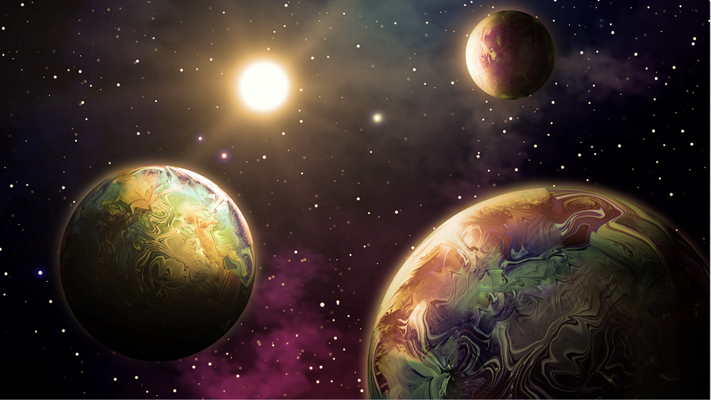
Explore and Search
Input Keywords to find specific celestial bodies

Slide 6
Adding Entries
Select type of celestial body to add (Star, Planet, Satellite)
Select subtype (White dwarf, Gas Giant, Intermediate Moon, etc.)
Enter the parameters for which the program asks

Slide 7
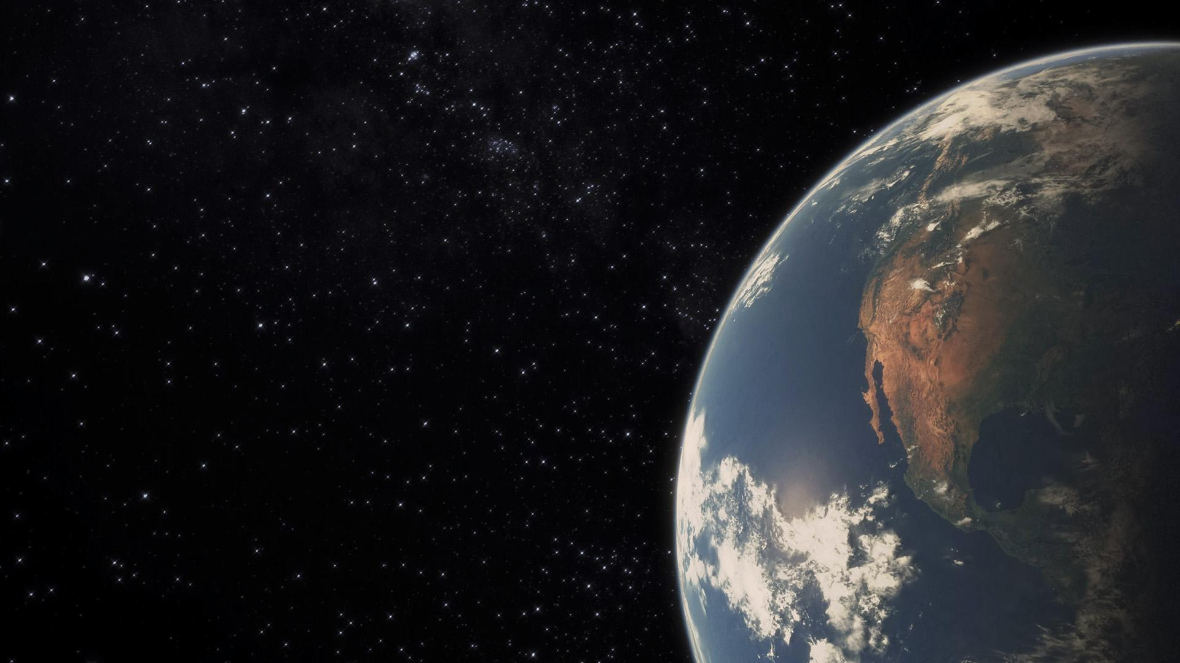
Thank you for the attention!

